Slide 1



Workshop 2018
C# Scripting and Plugin Development
for Grasshopper
A Gentle Introduction to Hardcore Programming for Computational Design
LONG NGUYEN
Research Associate
Institute for Computational Design (ICD)
University of Stuttgart
26,27,28 / 04 / 2018

Slide 2
Aims
Grasp the basics of C# language.
Gain better understanding of object-oriented programming
Go beyond visual scripting in Grasshopper with the C# Script component
Become familiar with RhinoCommon library
Improve your general programming skills
Learn to use Visual Studio
Learn to create plugins for Grasshopper !!!

Slide 3
Day 1
26/04/2018
Intro to C# language
The C# Script component in Grasshopper
RhinoCommon (Pointn, Vector, Curve, etc…)
Exercise: Circle relaxation and Curve Subdivision Growth
Visual Studio
Create Grasshopper plugins
Objected-oriented programming
Meshes
Exercise: mesh growth based on subdivision and collision avoidance
Day 2
27/04/2018
Day 3
28/04/2018
Computational Complexity
Spatial data structure
Speed up collision detection with R-Tree
Using external libraries
IronPython and .NET interop

Slide 4
Why C# ?
Mature, well documented, big community
It is a .NET language
RhinoCommon is based on .NET
Many other APIs are also based on .NET
Static-typed (more on this later)
Faster than IronPython

Slide 5

Benchmark Demos
VB
C#

Slide 6
Interpreted vs. compiled language (simplified)

Slide 7
Compiled languages (C++, Pascal)
Source Code
Compiler
Machine Code
Interpreted languages (Python)
Machine instructions
Source Code
Interpreter
Semi-Compiled languages (C#, VisualBasic, Java)
Source Code
Compiler
Intermediate Code
Intermediate Code
JIT Compiler
Machine instructions

Slide 8
Variables and Data “type”
C#
Python
int a;
a = 12;
double b = 3.14;
string myText = "Hello Rhino";
b = 1.23
a = 12
b = 3.14
myText = "Hello Rhino"
b = 1.23
Implicit typing
Explicit typing

Slide 9
Data “type”
Python
C#
a = 12
a = "I am awesome"
int a = 12;
string a = "I am awesome";
Dynamic typing
Static typing

Slide 10
Type: Python vs. C#
Python
C#
myVariable = 3.14
…
…
…
myVariabel = 1.414
double myVariable = 3.14
…
…
…
myVariabel = 1.414

Slide 11
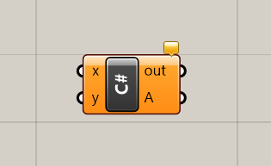
The C# Script component

Slide 12
Live example
A component that adds two numbers together

Slide 13
The “new” keyword
Point3d A = new Point3d();
Point3d B = new Point3d(0.0, 1.0, 2.0);
Point3d C = B;

Slide 14
Live example
Create a point from x, y and z

Slide 15
“If” statement
C#
Python
if (a > b)
{
Print("a is bigger than b");
Print("b is smaller than a");
}
else
{
Print("a is bigger than b");
Print("b is smaller than a");
}
if a > b:
print("a is bigger than b")
print("b is smaller than a")
else:
print("a is smaller than b")
print("b is bigger than a")

Slide 16
“for” loop
Python
C#
for i in range (0, 5):
print(i)
for (int i = 0; i < 5; i++)
{
Print(i.ToString());
}

Slide 17
List
Python
myNumbers = [0.5, 3.14]
myNumbers.append(1.23)
myNumbers.append(2.35)
print(myNumbers[0])
C#
List<double> myNumbers = new List<double>(){0.5, 3.14};
myNumbers.Add(1.23);
myNumbers.Add(2.35);
Print(myNumbers[0].ToString());

Slide 18
Live example
Create a linear array of points using for loop

Slide 19
“foreach” Loop
C#
foreach (Point3d point in points)
{
// do something with “point”>
}

Slide 20
Live example
Create a list of circles from a list of center points
(using foreach loop)

Slide 21
Live example
Subdivision Curve

Slide 22
Live Example: Subdivision Curve
1
3
2
4
0
Chaikin subdivision scheme (1974)
Converges to Quadratic B-Spline

Slide 23
Live Example: Subdivision Curve
private void RunScript(List<Point3d> controlPoints, int iterationCount, ref object curve)
{
for (int j = 0; j < iterationCount; j++)
{
List<Point3d> newControlPoints = new List<Point3d>();
for (int i = 0; i < controlPoints.Count - 1; i++)
{
Point3d oneQuarterPoint = 0.75 * controlPoints[i] + 0.25 * controlPoints[i + 1];
newControlPoints.Add(oneQuarterPoint);
Point3d threeQuarterPoint = 0.25 * controlPoints[i] + 0.75 * controlPoints[i + 1];
newControlPoints.Add(threeQuarterPoint);
}
controlPoints = newControlPoints;
}
curve = new PolylineCurve(controlPoints);
}
3/4
i + 1
1/4
i

Slide 24
Live Example: Subdivision Curve
private void RunScript(List<Point3d> controlPoints, int iterationCount, ref object curve)
{
for (int j = 0; j < iterationCount; j++)
{
List<Point3d> newControlPoints = new List<Point3d>();
for (int i = 0; i < controlPoints.Count - 1; i++)
{
newControlPoints.Add(0.75 * controlPoints[i] + 0.25 * controlPoints[i + 1]);
newControlPoints.Add(0.25 * controlPoints[i] + 0.75 * controlPoints[i + 1]);
}
controlPoints = newControlPoints;
}
curve = new PolylineCurve(controlPoints);
}
3/4
i + 1
1/4
i

Slide 25
Why curve degree is usually 3 by default ?

Slide 26
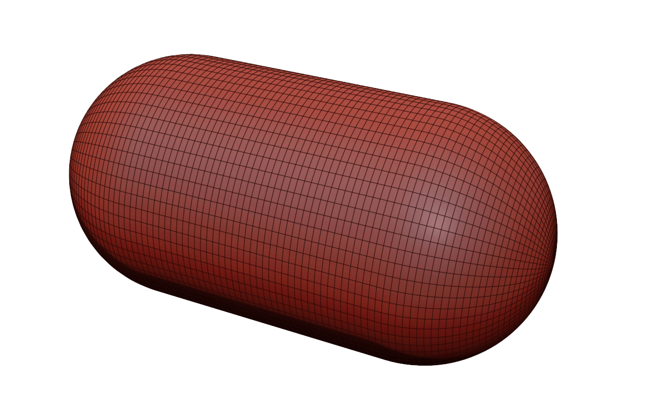
Degree 2 is smooth, but not smooth enough

Slide 27
Degree 2 is smooth, but not smooth enough

Slide 28
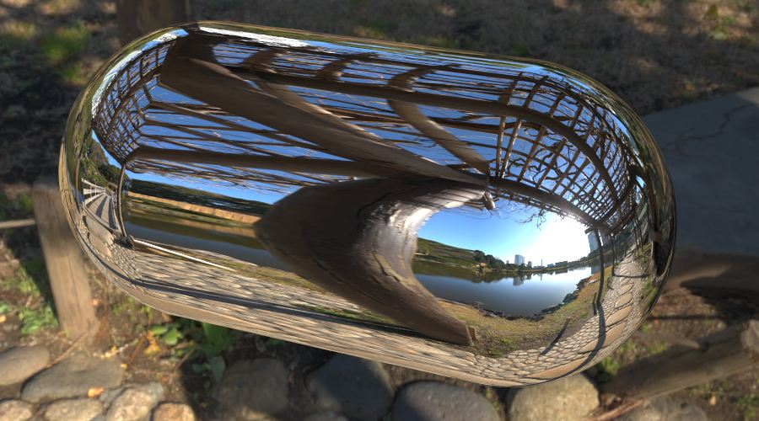
Degree 2 is smooth, but not smooth enough

Slide 29
Catmull-Clark Subdivision Scheme (1978)
Converges to cubic B-spline
for (int i = 0; i < controlPoints.Count - 3; i++)
{
newControlPoints.Add(0.5 * controlPoints[i] + 0.5 * controlPoints[i + 1]);
newControlPoints.Add(0.125 * controlPoints[i] + 0.75 * controlPoints[i + 1] +
0.125 * controlPoints[i + 2]);
}

Slide 30
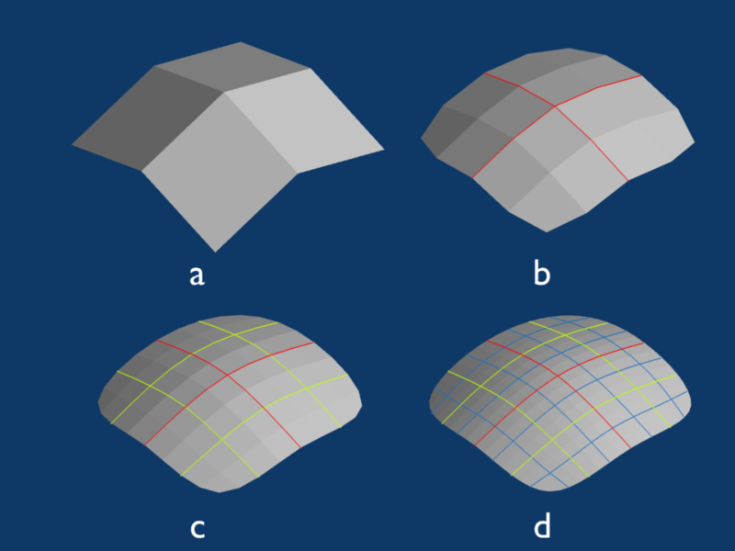
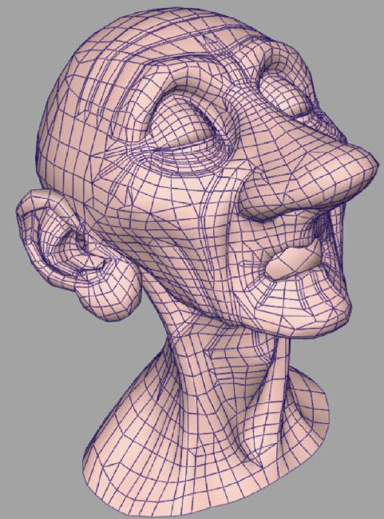
Subdivision Surfaces
Catmull-Clark Subdivision Surface

Slide 31
Variable and data types
in more details

Slide 32

What is a “variable” anyway?
int a = 12;
int b = a;
a = 7;
Point3d A = new Point3d(0, 0, 0);
Point3d B = A;
A.Z = 2;
List<string> a = new List<string>();
a.Add("Hello");
List<string> b = a;
a.Add("Goodbye");

Slide 33
What is actually “stored” inside a variable?
int a = 12;
int b = a;
a = 7;
a
12
a
7
b
b
12

Slide 34
What is actually “stored” inside a variable?
Point3d A = new Point3d(0, 0, 0);
Point3d B = A;
A.Z = 2;
A
(0, 0, 2)
A
(0, 0, 0)
B
(0, 0, 0)
B

Slide 35
What is actually “stored” inside a variable?
List<string> a = new List<string>();
a.Add("Hello");
List<string> b = a;
a.Add("Goodbye");
a
b
The actual list
<empty>
The actual list
“Hello”
The actual list
“Hello”, “Goodbye”

Slide 36
So, there are two “kinds” of data types
Value type
int, double, …
Point3d, Vector3D, Circle …
Reference type
List, …
Curve, Brep, Surface …
Data is copied
by the “equal” operator
The reference (to the actual data) is copied
It is similar in Python (loosely speaking)

Slide 37
Next:
Functions/Methods

Slide 38
What is a function?
A way to package a piece of code so that
we can conveniently re-use it many times

Slide 39
Defining a function/method
Python
def ComputeCylinderVolume(r, h):
baseArea = 3.14 * r * r
volume = baseArea * h
return volume
C#
double ComputeCylinderVolume (double r, double h)
{
double baseArea = 3.14 * r * r;
double volume = baseArea * h;
return volume;
}

Slide 40
Live example
Functions/Methods

Slide 41
Live Example: Functions/Methods
class ScriptInstance : GH_SriptInstance
{
private void RunScript()
{
double volume1 = ComputeCylinderVolume(1.0, 1.0);
Print(volume1.ToString());
double volume2 = ComputeCylinderVolume(2.5, 1.7);
Print(volume2.ToString());
}
double ComputeCylinderVolume (double r, double h)
{
double baseArea = 3.14 * r * r;
double volume = baseArea * h;
return volume;
}
}

Slide 42
Combining statements
class ScriptInstance : GH_SriptInstance
{
private void RunScript()
{
Print(ComputeCylinderVolume(1.0, 1.0).ToString());
Print(ComputeCylinderVolume(2.5, 1.7).ToString());
}
double ComputeCylinderVolume (double r, double h)
{
double baseArea = 3.14 * r * r;
double volume = baseArea * h;
return volume;
}
}

Slide 43
Combining statements
class ScriptInstance : GH_SriptInstance
{
private void RunScript()
{
Print(ComputeCylinderVolume(1.0, 1.0).ToString());
Print(ComputeCylinderVolume(2.5, 1.7).ToString());
}
double ComputeCylinderVolume (double r, double h)
{
return 3.14 * r * r * h;
}
}

Slide 44
A function/method is a “black box”
r
ComputeCylinderVolume
?
volume
h
Hide the details from the “user”

Slide 45
Function Overloading

Slide 46
Same function, different flavours
double ComputeCylinderVolume1(double r, double h)
{
return 3.14 * r * r * h;
}
double ComputeCylinderVolume2(double r, Point3d bottomCenter, Point3d topCenter)
{
double h = bottomCenter.DistanceTo(topCenter);
return 3.14 * r * r * h;
}

Slide 47
Using the same function name for different flavours
double ComputeCylinderVolume (double r, double h)
{
return 3.14 * r * r * h;
}
double ComputeCylinderVolume (double r, Point3d bottomCenter, Point3d topCenter)
{
double h = bottomCenter.DistanceTo(topCenter);
return 3.14 * r * r * h;
}
double myCylinderVolume = ComputeCylinderVolume(2.13, 5.0);
Point3d bottomCenter = Point3d.Origin;
Point3d topCenter = new Point3d(2.0, 3.0, 5.0);
double yourCylinderVolume = ComputeCylinderVolume(2.0, bottomCenter, topCenter);

Slide 48
Using the same function name for different flavours
double ComputeCylinderVolume (double r, double h)
{
return 3.14 * r * r * h;
}
double ComputeCylinderVolume (double r, Point3d bottomCenter, Point3d topCenter)
{
double h = bottomCenter.DistanceTo(topCenter);
return 3.14 * r * r * h;
}
Behind the Scene: Function Signatures
ComputeCylinderVolume(double, double);
ComputeCylinderVolume(double, Point3d, Point3d);

Slide 49
This is NOT allowed …
Because the two functions definitions cannot have the same signature
class ScriptInstance : GH_SriptInstance
{
...
double ComputeCylinderVolume(double r, double h)
{
...
}
double ComputeCylinderVolume(double radius, double height)
{
...
}
}
Error Message:
Type “ScriptInstance” already defines a member called “ComputeCylinderVolume” with the same parameter types

Slide 50
… Neither is this
Still have the same signature (type of the return value is not part of the signature)
class ScriptInstance : GH_SriptInstance
{
...
double ComputeCylinderVolume(double r, double h)
{
...
}
void ComputeCylinderVolume(double radius, double height)
{
...
}
}
Error Message:
Type “ScriptInstance” already defines a member called “ComputeCylinderVolume” with the same parameter types

Slide 51
If there is no matching signature …
double ComputeCylinderVolume (double r, double h)
{
...
}
double ComputeCylinderVolume (double r, Point3d bottomCenter, Point3d topCenter)
{
...
}
double myCylinderVolume = ComputeCylinderVolume();
Error Message:
No overloaded method for “computeCylinderVolume” takes 0 arguments

Slide 52
If there is no matching signature …
double ComputeCylinderVolume (double r, double h)
{
...
}
double ComputeCylinderVolume (double r, Point3d bottomCenter, Point3d topCenter)
{
...
}
double myCylinderVolume = ComputeCylinderVolume(2.0, Point3d.Origin);
Error Message:
The best overloaded method match for “ComputeCylinderVolume(double, double)” has some invalid arguments

Slide 53
Parameter Passing
i.e. how data are actually input into functions?

Slide 54
What happens to the parameter?
void Foo(double someNumber)
{
someNumber = someNumber + 1.0;
}
double myNumber = 2.0;
Foo(myNumber);
Print(myNumber.ToString());
Live example: Let’s try it out

Slide 55
Parameter passing: Pass-by-Value
void Foo(double someNumber)
{
someNumber = someNumber + 1.0;
}
double myNumber = 2.0;
Foo(myNumber);

Slide 56
Pass-by-Value for reference type
void Foo(List<string> texts)
{
texts.Add(“Oh Yeah !!!”);
}
List<string> myTexts = new List<string>();
Print(myTexts.Count.ToString());
Foo(myTexts);
Print(myTexts.Count.ToString());

Slide 57
Recall: there are two “kinds” of data types
Value type
int, double, …
Point3d, Vector3D, Circle …
Reference type
List, …
Curve, Brep, Surface …
Data is copied
by the “equal” operator
The reference (to the actual data) is copied

Slide 58
Pass-by-Reference: “ref” keyword
void Foo(double a)
{
a = a + 1.0;
}
void Foo(ref double a)
{
a = a + 1.0;
}
double myNumber = 2.0;
Foo(myNumber);
double myNumber = 2.0;
Foo(ref myNumber);

Slide 59
Any question so far ?

Slide 60
You may wonder …
Using the ref keyword with reference-type parameter
void Foo(ref List<string> texts)
{
texts.Add(“Oh Yeah !!!”);
}
Let’s ignore this for now

Slide 61
Store result in ref parameters
void ComputeAreaAndVolume(double r, ref double area, ref double volume)
{
area = 4.0 * 3.14 * r * r;
volume = 4.0 / 3.0 * 3.14 * r * r * r;
}
double areaResult = 0.0;
double volumeResult = 0.0;
ComputeAreaAndVolume(1.32, ref areaResult, ref volumeResult);

Slide 62
Store result in out parameters (better)
void ComputeAreaAndVolume(double r, out double area, out double volume)
{
area = 4.0 * 3.14 * r * r;
volume = 4.0 / 3.0 * 3.14 * r * r * r;
}
double areaResult;
double volumeResult;
ComputeAreaAndVolume(1.32, out areaResult, out volumeResult);

Slide 63
An example of “out” parameter from RhinoCommon
double t;
boolean success = myCurve.ClosestPoint(myPoint, out t);
if (success)
myCurve.PointAt(t);
RhinoCommon could have been designed to work like this …
double t = myAwesomeCurve.ClosestPoint(myPoint);
myAwesomeCurve.PointAt(t);

Slide 64
Live example
Adaptively subdividing a curve

Slide 65
Live example: Adaptively subdividing a curve
De Casteljau's algorithm

Slide 66
Live example: Adaptively subdividing a curve
void DivideCurve(Curve curve, double tStart, double tEnd, double tolerance, List<LineCurve> segments)
{
Point3d startPoint = curve.PointAt(tStart);
Point3d endPoint = curve.PointAt(tEnd);
Point3d middlePoint = 0.5 * (startPoint + endPoint);
double tClosest;
curve.ClosestPoint(middlePoint, out tClosest);
double distance = curve.PointAt(tClosest).DistanceTo(middlePoint);
if (distance < tolerance)
segments.Add(new LineCurve(startPoint, endPoint));
else
{
double tMiddle = 0.5 * (tStart + tEnd);
DivideCurve(curve, tStart, tMiddle, tolerance, segments);
DivideCurve(curve, tMiddle, tEnd, tolerance, segments);
}
}
closest
end
start
middle

Slide 67
Live example: Adaptively subdividing a curve
class ScriptInstance : GH_SriptInstance
{
private void RunScript(Curve curve, double tolerance, ref object A)
{
List<LineCurve> segments = new List<LineCurve>();
DivideCurve(curve, 0.0, 1.0, tolerance, segments);
A = segments;
}
void DivideCurve(Curve curve, double tStart, double tEnd, double tolerance,
List<LineCurve> segments)
{
...
}
}

Slide 68
Generating Randomness

Slide 69
The random generator object
private void RunScript(...)
{
Random myRandomGenerator = new Random();
double myRandomDouble = myRandomGenerator.NextDouble();
Print(myRandomDouble.ToString());
for (int i = 0; i < 10; i++)
{
Print(myRandomGenerator.Next(10, 20).ToString());
}
}

Slide 70
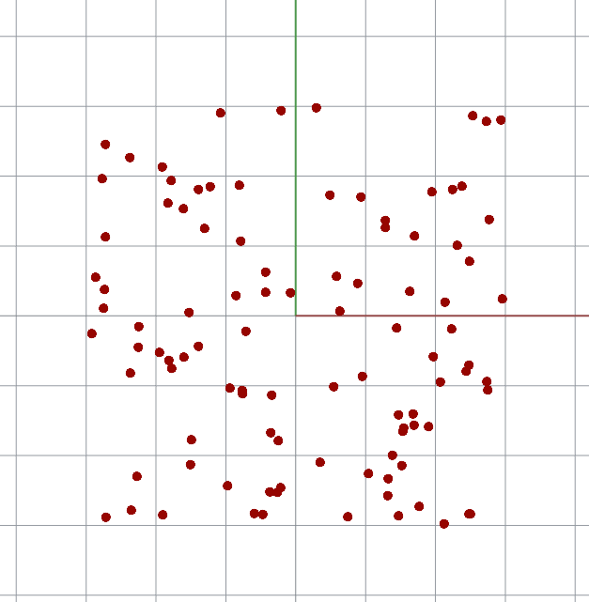
Generate random points within a predefined range
private void RunScript(int iCount, ref object oPoints)
{
Random myRandomGenerator = new Random();
List<Point3d> points = new List<Point3d>();
for (int i = 0; i < iCount; i++)
{
double x = myRandomGenerator.NextDouble() * 6.0 - 3.0;
double y = myRandomGenerator.NextDouble() * 6.0 - 3.0;
double z = 0.0;
Point3d myRandomPoint = new Point3d(x, y, z);
points.Add(myRandomPoint);
}
oPoints = points;
}

Slide 71
Persistent Data
i.e. how to maintain the data states between
consecutive executions of the C# Script component

Slide 72
Persistent Data in the C# Script component
class ScriptInstance : GH_SriptInstance
{
private void RunScript()
{
int n = 0;
n += 1;
Print(n.ToString());
}
}

Slide 73
Persistent Data in the C# Script component
class ScriptInstance : GH_SriptInstance
{
private void RunScript()
{
n += 1;
Print(n.ToString());
}
int n = 0;
}

Slide 74
How to “reset” persistent data?
class ScriptInstance : GH_SriptInstance
{
private void RunScript(bool reset)
{
if (reset == true)
{
n = 0;
}
else
{
n += 1;
Print(n.ToString());
}
}
int n = 0;
}

Slide 75
How to “reset” persistent data?
class ScriptInstance : GH_SriptInstance
{
private void RunScript(bool reset)
{
if (reset == true)
{
n = 0;
return;
}
n += 1;
Print(n.ToString());
}
int n = 0;
}

Slide 76
Circles Relaxation

Slide 77
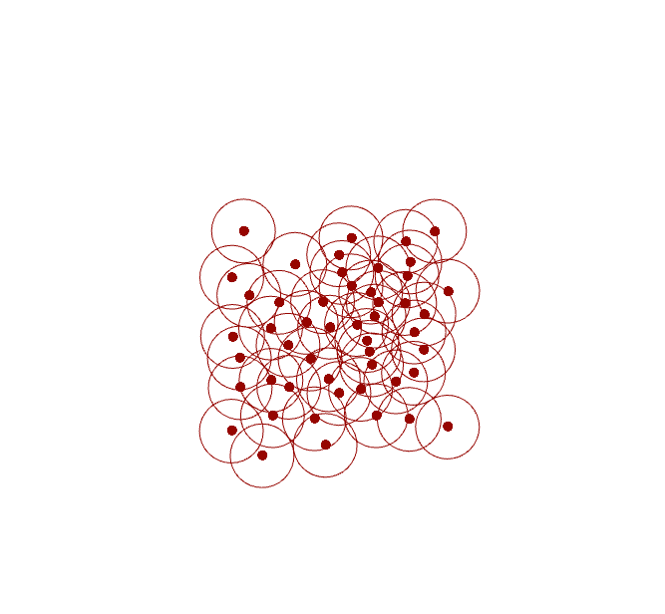
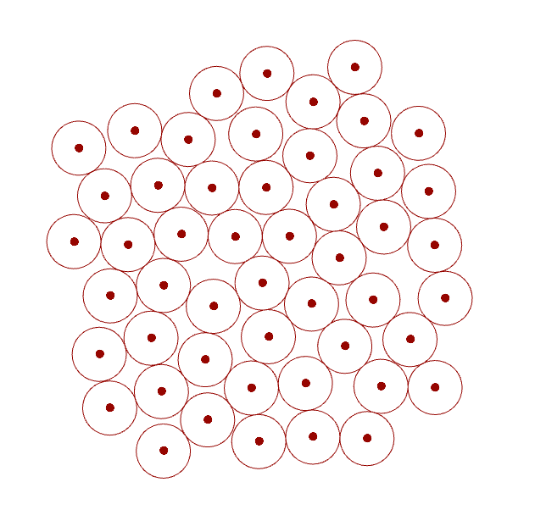
Circle Relaxation
Circles overlapping
No more overlapping

Slide 78
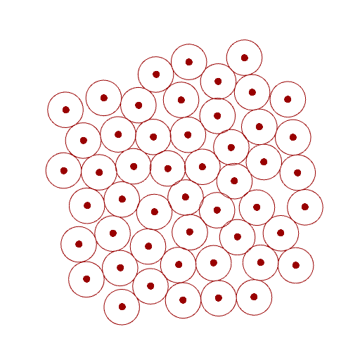
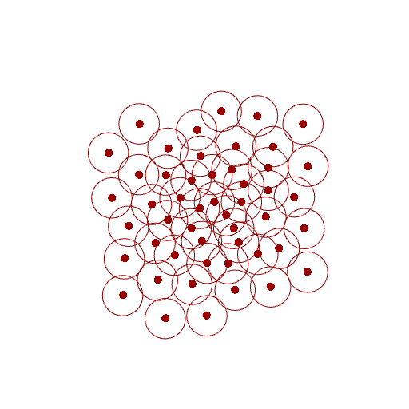
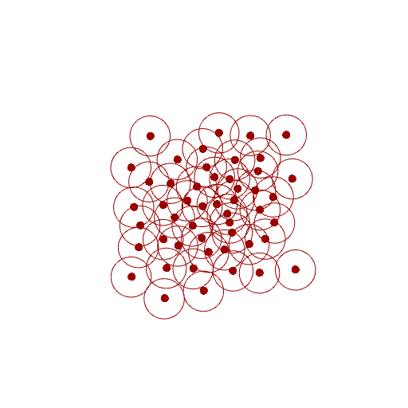
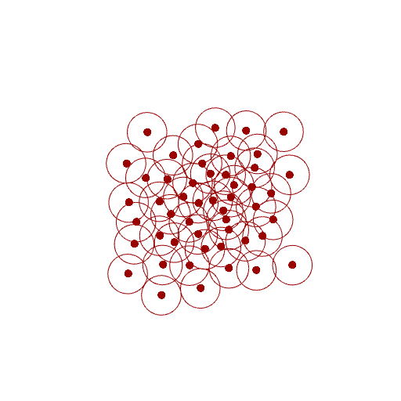
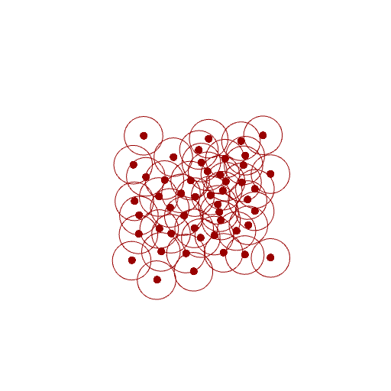
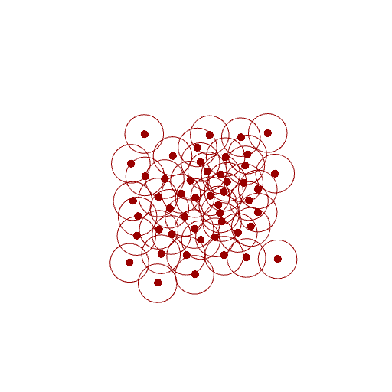
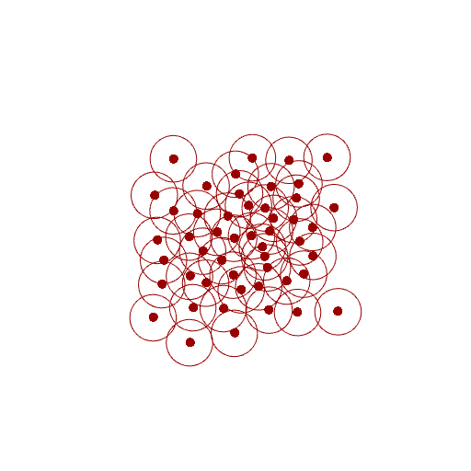
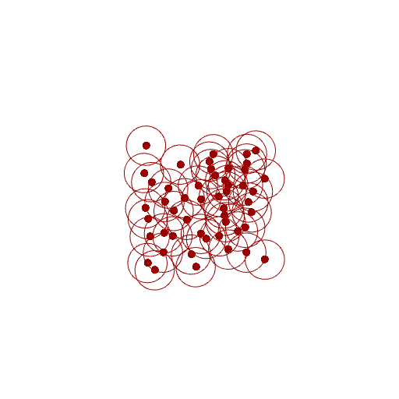


Relaxation:
Iteratively push the overlapping circles away from each other
Iteration 0
1
2
3
4
5
6
7
…
17
…
100

Slide 79
Super simple if there only 2 circles
Need only 1 iteration

Slide 80
If there are more than 2 circles:
Step 1: Consider each pair of circles and calculate the move vectors to push them apart.

Slide 81
If there are more than 2 circles:
Step 2: Compute the AVERAGE move vector for each circle

Slide 82
If there are more than 2 circles:
Step 3: Move each circle according to its AVERAGE move vector.

Slide 83
If there are more than 2 circles:
Notice how the overlapping has been slightly reduced!

Slide 84
If there are more than 2 circles:
Repeat the entire process many times
until there is near 0 overlapping

Slide 85
private void RunScript(List<Point3d> iStartingPositions, int iIterationCount, ref object oGeometry)
{
List<Point3d> centers = new List<Point3d>(iStartingPositions);
for (int iteration = 0; iteration < iIterationCount; iteration++)
{
List<Vector3d> totalMoves = new List<Vector3d>();
List<double> collisionCounts = new List<double>();
for (int i = 0; i < centers.Count; i++)
{
totalMoves.Add(new Vector3d(0.0, 0.0, 0.0));
collisionCounts.Add(0.0);
}
// ...
}
oGeometry = centers;
}

Slide 86
for (int iteration = 0; iteration < iIterationCount; iteration++)
{
// ...
double collisionDistance = 2.0;
for (int i = 0; i < centers.Count; i++)
for (int j = i + 1; j < centers.Count; j++)
{
double d = centers[i].DistanceTo(centers[j]);
if (d > collisionDistance) continue;
Vector3d move = centers[i] - centers[j];
move.Unitize();
move *= 0.5 * (collisionDistance - d);
totalMoves[i] += move;
totalMoves[j] -= move;
collisionCounts[i] += 1.0;
collisionCounts[j] += 1.0;
}
for (int i = 0; i < centers.Count; i++)
if (collisionCounts[i] != 0.0)
{
Vector3d averageMove = totalMoves[i] / collisionCounts[i];
centers[i] += averageMove;
}
}
Centers[i]
Centers[j]

Slide 87
Output and display intermediate result
private void RunScript(bool iReset, List<Point3d> iStartingPositions, ref object oCenters)
{
if (iReset)
centers = new List<Point3d>(iStartingPositions);
// ... Update centers to the next iteration ...
oCenters = centers;
}
// <Custom additional code>
List<Point3d> centers;
// </Custom additional code>

Slide 88
Curve Subdivision Growth

Slide 89
Split a segment if it has grown sufficient long
private void RunScript(bool iReset, List<Point3d> iStartingPositions, int iMaxCenterCount, ref object oCenters)
{
// After the centers has been moved to the next positions
if (centers.Count < iMaxCenterCount)
{
List<int> splitIndices = new List<int>();
for (int i = 0; i < centers.Count - 1; i++)
if (centers[i].DistanceTo(centers[i + 1]) > 1.9)
splitIndices.Add(i + 1 + splitIndices.Count);
foreach (int splitIndex in splitIndices)
{
Point3d newCenter = 0.5 * (centers[splitIndex - 1] + centers[splitIndex]);
centers.Insert(splitIndex, newCenter);
}
}
oCenters = centers;
}
3
1
4
1
4
0
7
2
5

